Slide 1
Measurement and Dimensions of Human Development
- Kishor Goswami

Slide 2
There are two basic views about human development.
A few believe it as increase in the quality of life with other values like equity, basic human rights and so on. They also concern about equality between and within generations - and to that degree with sustainable human development. This broad approach is being even pursued in the UNDP’s HDRs.
Others believe that human development focus primarily on basic needs and well-being and are not concerned with other values.
Both the views focuses on direct measures of the quality of life.

Slide 3
Human Development Index
In some basic respects the world is a much better place today than it was in 1990 or in 1970.
Of 135 countries in UNDP’s sample for 1970–2010, with 92 percent of the world’s people, only 3-the Democratic Republic of the Congo, Zambia and Zimbabwe- have a lower HDI today than in 1970.
Not all countries have progressed rapidly, and the variation is striking. Over the past 40 years a quarter of developing countries saw their HDI increase less than 20 percent, another quarter, more than 65 percent. These differences partly reflect different starting points-less developed countries have on average faster progress in health and education than more developed ones do.

Slide 4
But half the variation in HDI performance is unexplained by initial HDI, and countries with similar starting points experience remarkably different evolutions, suggesting that country factors such as policies, institutions and geography are important.
Progress in income varies much more. Despite aggregate progress, there is no convergence in income in contrast to health and education. Because, on average, rich countries have grown faster than poor ones over the past 40 years.
The divide between developed and developing countries persists: a small subset of countries has remained at the top of the world income distribution, and only a handful of countries that started out poor have joined that high-income group.

Slide 5
Research shows the lack of a significant correlation between economic growth and improvements in health and education.
Income is critical in determining people’s command over the resources necessary to gain access to food, shelter and clothing and in making possible much broader options-such as working in meaningful and intrinsically rewarding activities or spending more time with loved ones.
Income growth can indicate that opportunities for decent work are expanding, though this is not always so, and economic contractions and associated job losses are bad news for people around the world.
Income is also the source of the taxes and other revenues that governments need in order to provide services and undertake redistributive programs. Thus, increasing income on a broad basis remains an important policy priority.

Slide 6
Role of institutions:
The economic liberalization in India sought to ease an overly restrictive and family-dominated business environment by reducing regulation and introducing more competition. In short, while institutions are a key determinant of human development, how they interact with their context merits careful investigation.
One important aspect is how relationships between markets and states are organized. Governments have addressed, in a range of ways, the tension between the need for markets to generate income and dynamism and the need to deal with market failures.
Markets may be necessary for sustained economic dynamism, but they do not automatically bring progress in other dimensions of human development.
Development that overly favours rapid economic growth is rarely sustainable. In other words, a market economy is necessary, but not enough.

Slide 7
For example, firms that produce cheap labour-intensive goods or that exploit natural resources may not want a more educated workforce and may care little about their workers’ health if there is an abundant pool of labour.
Without complementary societal and state action, markets can be weak on environmental sustainability, creating the conditions for environmental degradation, even for such disasters as mud flows in Java and oil spills in the Gulf of Mexico.
Regulation, however, requires a capable state as well as political commitment, and state capability is often in short supply. Some developing country governments have tried to mimic the actions of a modern developed state without having the resources or the capacity to do so. For example, import substitution regimes in many Latin American countries floundered when countries tried to develop a targeted industrial policy.

Slide 8
Human Development
Human development is not only about health, education and income—it is also about people’s active engagement in shaping development, equity and sustainability, intrinsic aspects of the freedom people have to lead lives they have reason to value.
Lack of quantification is no reason to neglect or ignore some of the areas.

Slide 9
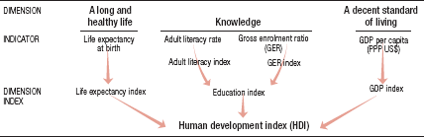
Human Development Index

Slide 10
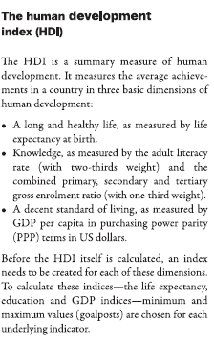

Slide 11
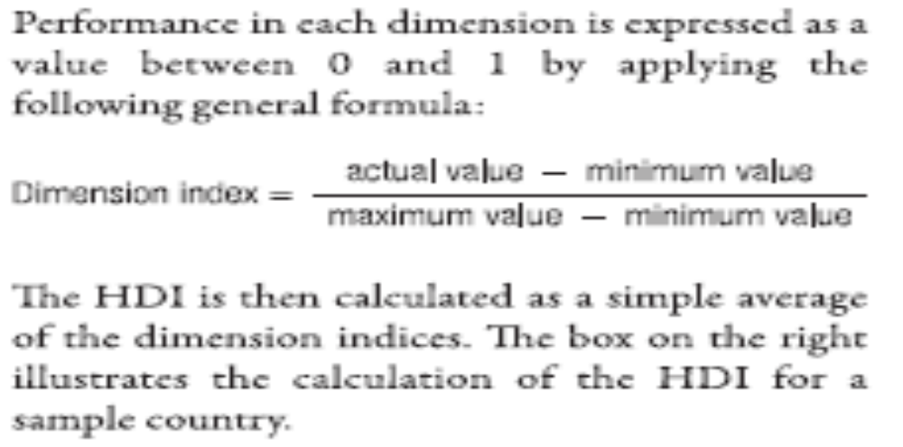
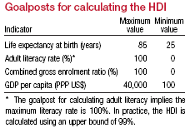

Slide 12
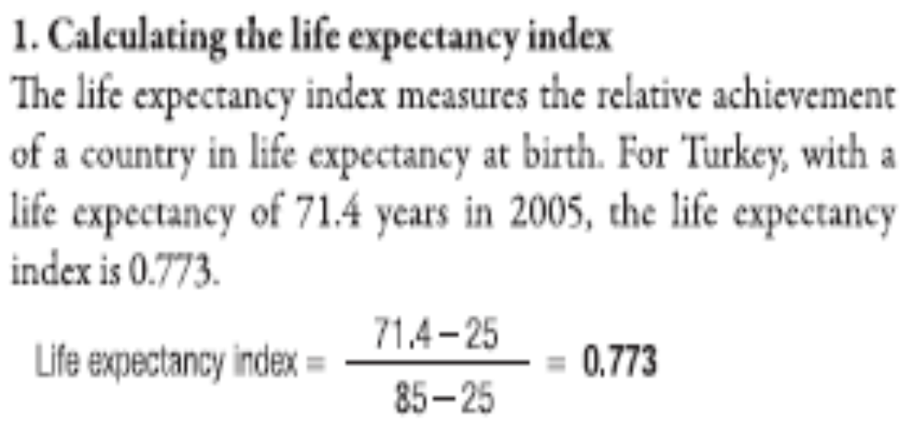
Calculating HDI: Turkey

Slide 13
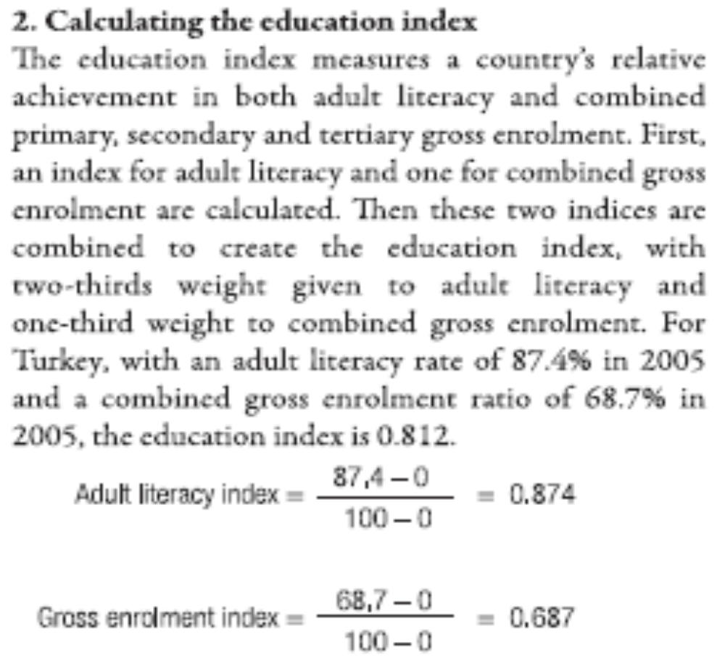

Slide 14
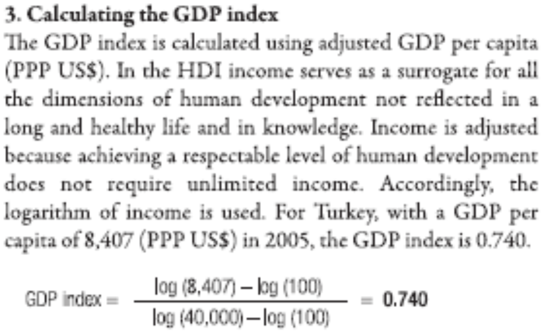

Slide 15
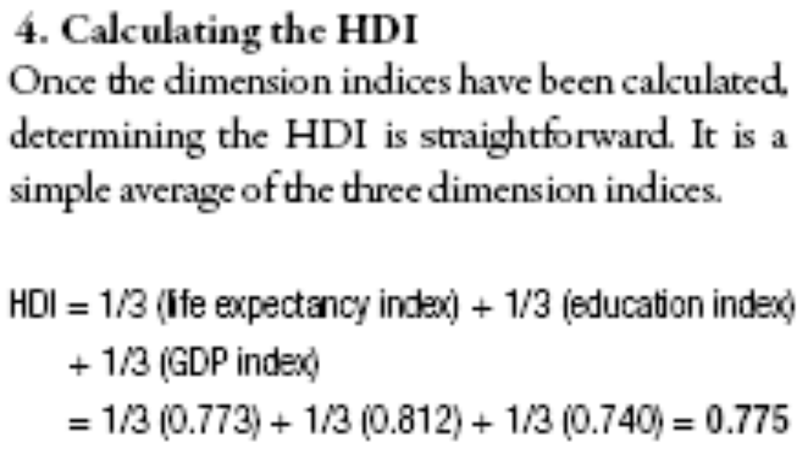

Slide 16
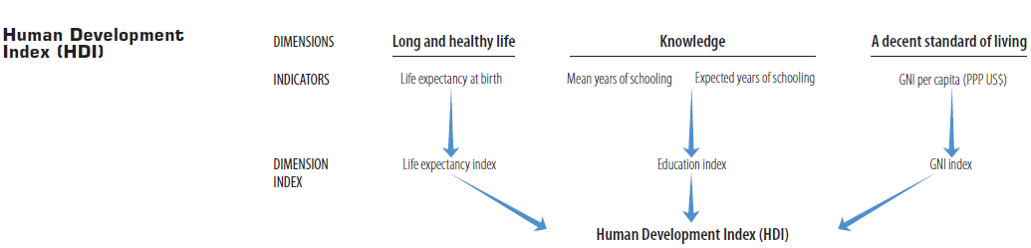
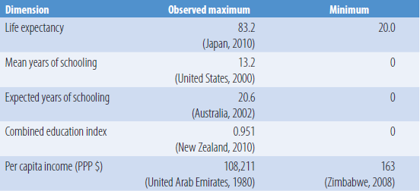
Modified Human Development Index (HDI)
Goalposts for the Human Development Index

Slide 17
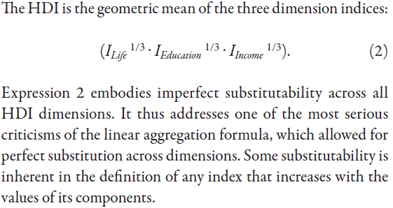
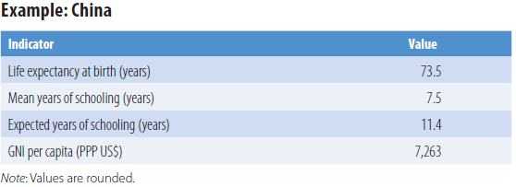

Slide 18
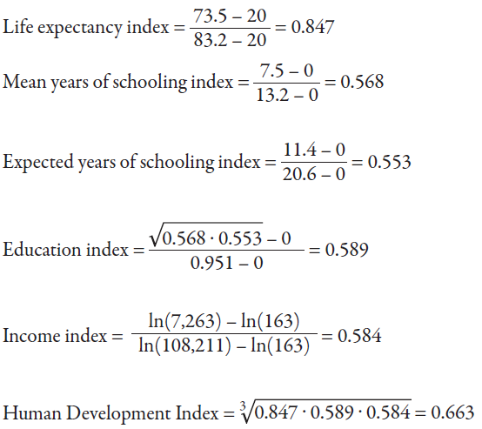

Slide 19
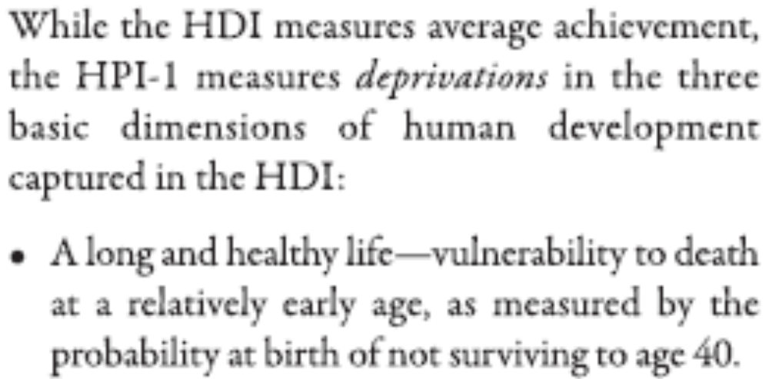
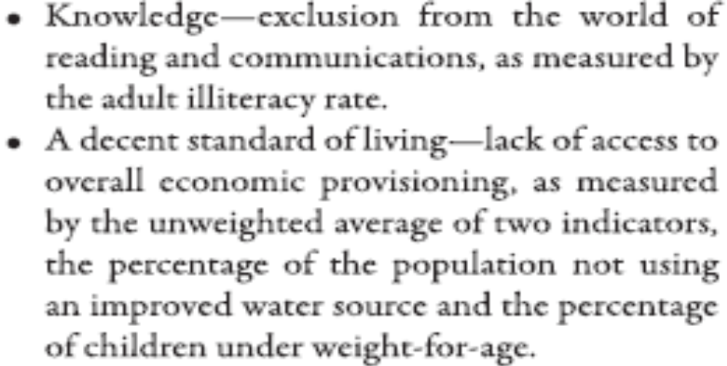
Human Poverty Index for Developing Countries (HPI 1)

Slide 20
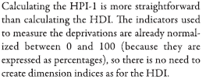

Slide 21
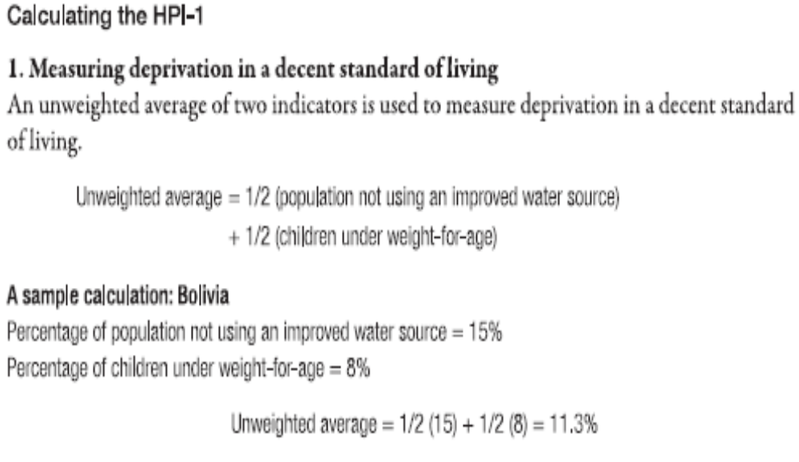

Slide 22
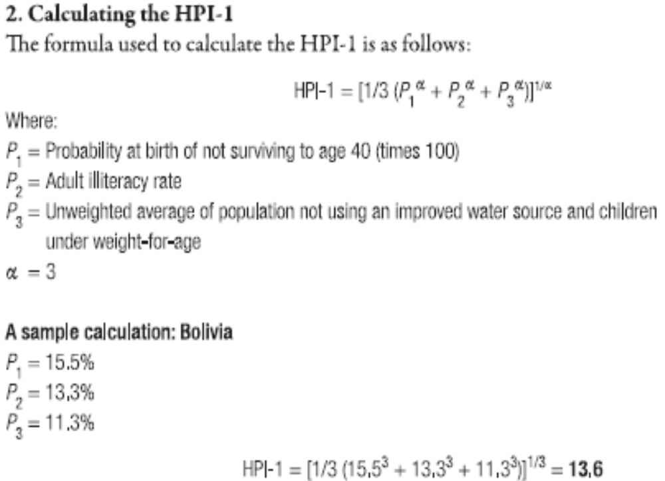

Slide 23
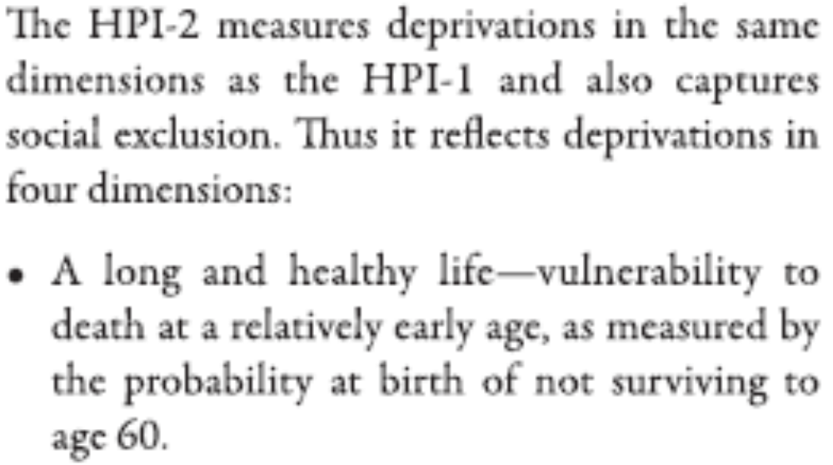
Human Poverty Index for selected OECD Countries (HPI 2)

Slide 24
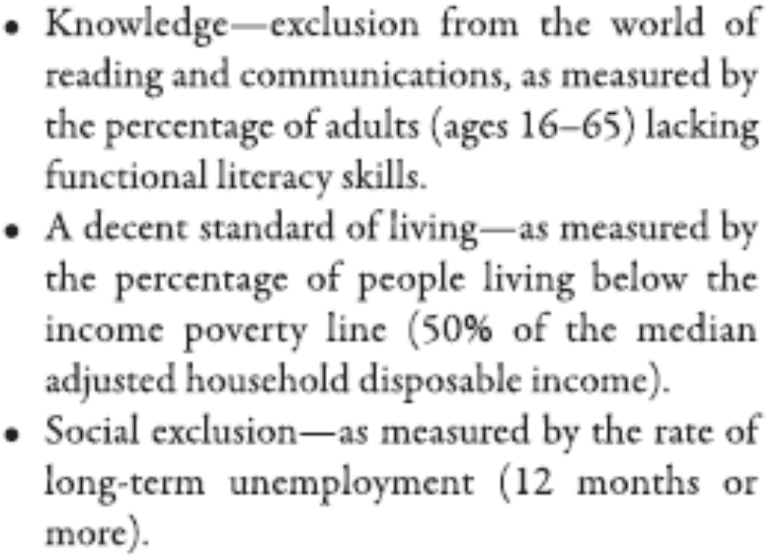

Slide 25
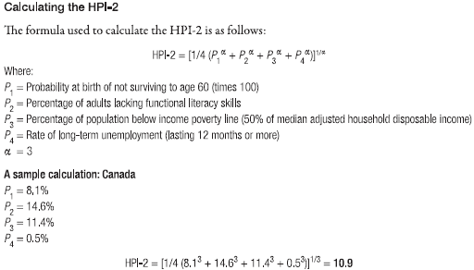

Slide 26
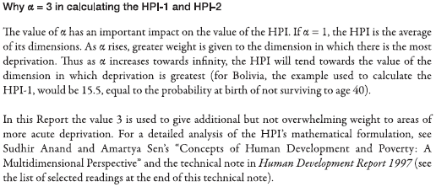

Slide 27
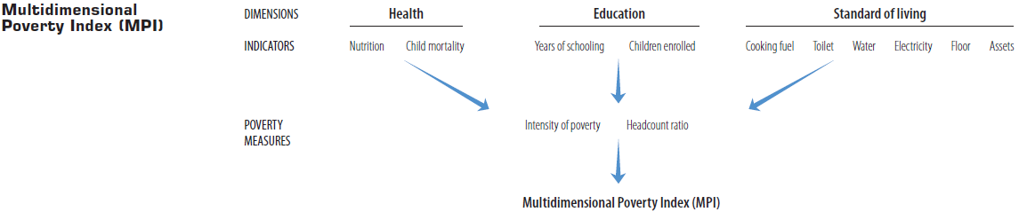
Multidimensional Poverty Index

Slide 28
The Multidimensional Poverty Index (MPI) identifies multiple deprivations at the individual level in health, education and standard of living. It uses micro data from household surveys, and-unlike the Inequality-adjusted Human Development Index-all the indicators needed to construct the measure must come from the same survey.
Each person in a given household is classified as poor or non-poor depending on the number of deprivations his or her household experiences. These data are then aggregated into the national measure of poverty.
Each person is assigned a score according to his or her household’s deprivations in each of the 10 component indicators, (d).

Slide 29
The maximum score is 10, with each dimension equally weighted (thus the maximum score in each dimension is 3⅓).
The health and education dimensions have two indicators each, so each component is worth 5/3 (or 1.67).
The standard of living dimension has six indicators, so each component is worth 5/9 (or 0.56).
The health thresholds are having at least one household member who is malnourished and having had one or more children die.
The education thresholds are having no household member who has completed five years of schooling and having at least one school-age child (up to grade 8) who is not attending school.

Slide 30
The standard of living thresholds relate to not having electricity, not having access to clean drinking water, not having access to adequate sanitation, using “dirty” cooking fuel (dung, wood or charcoal), having a home with a dirt floor, and owning no car, truck or similar motorized vehicle, and owning at most one of these assets: bicycle, motorcycle, radio, refrigerator, telephone or television.
To identify the multidimensionally poor, the deprivation scores for each household are summed to obtain the household deprivation, c.
A cut-off of 3, which is the equivalent of one-third of the indicators, is used to distinguish between the poor and nonpoor.

Slide 31

Technically this would be 3.33. Because of the weighting structure, the same households are identified as poor if a cut-off of 3 is used.
If c is 3 or greater, that household (and everyone in it) is multidimensionally poor. Households with a deprivation count between 2 and 3 are vulnerable to or at risk of becoming multidimensionally poor.
The MPI value is the product of two measures: the multidimensional headcount ratio and the intensity (or breadth) of poverty.
The headcount ratio, H, is the proportion of the population who are multidimensionally poor:
where q is the number of people who are multidimensionally poor and n is the total population.

Slide 32

The intensity of poverty, A, reflects the proportion of the weighted component indicators, d, in which, on average, poor people are deprived.
For poor households only, the deprivation scores are summed and divided by the total number of indicators and by the total number of poor persons:
where c is the total number of weighted deprivations the poor experience and d is the total number of component indicators considered (10 in this case).

Slide 33
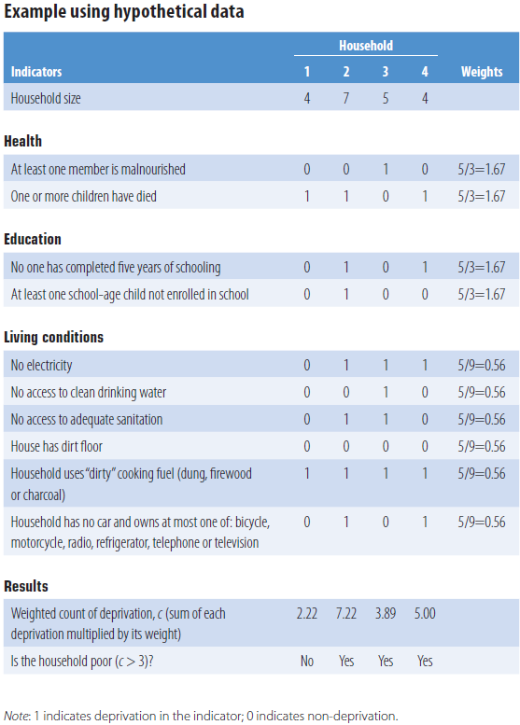
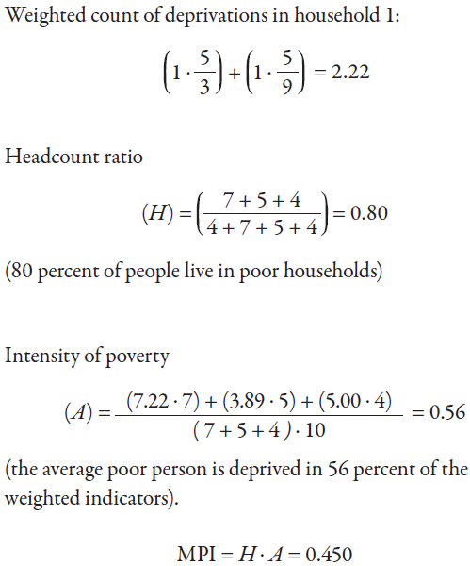


Slide 34
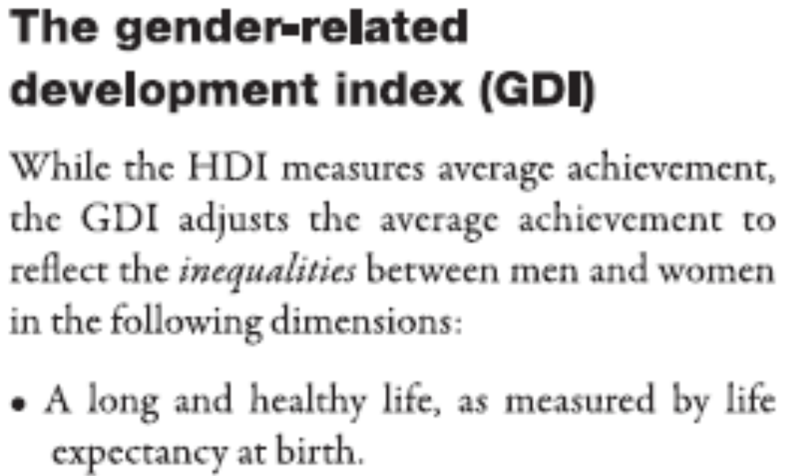
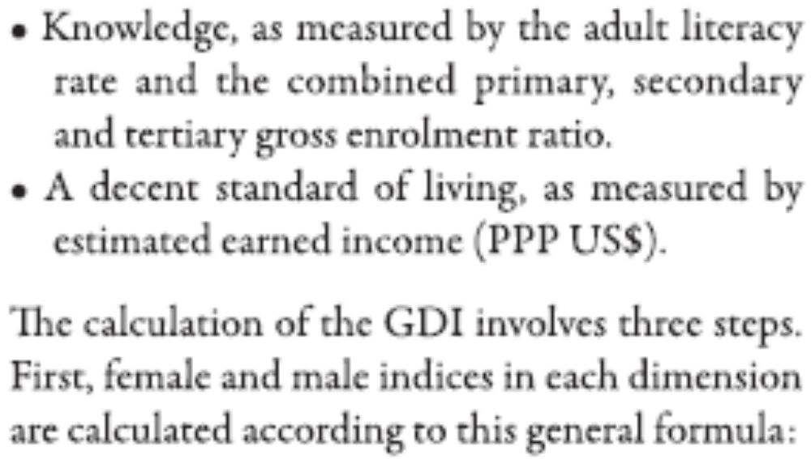

Slide 35
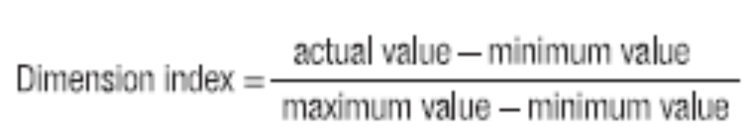
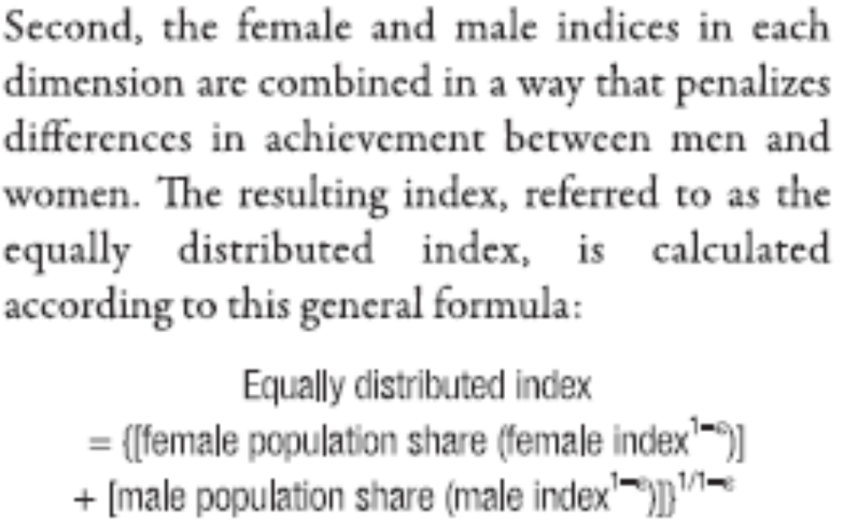

Slide 36
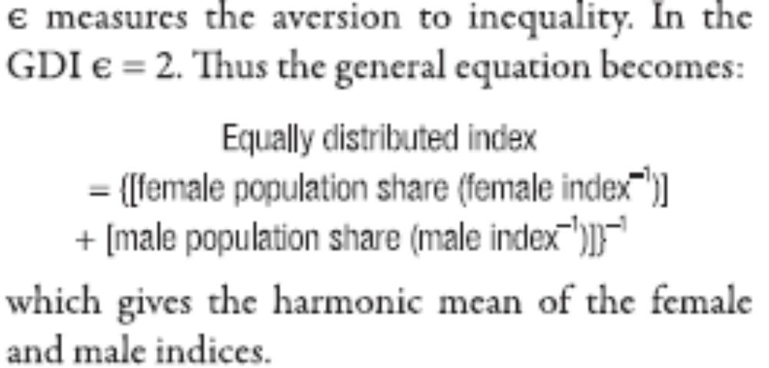
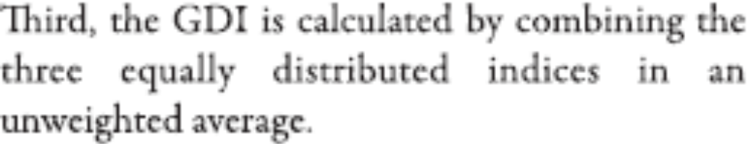

Slide 37
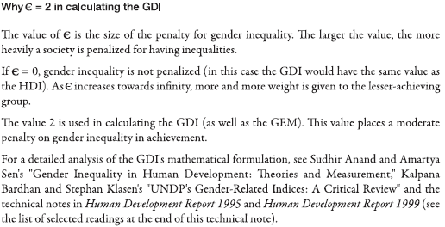

Slide 38
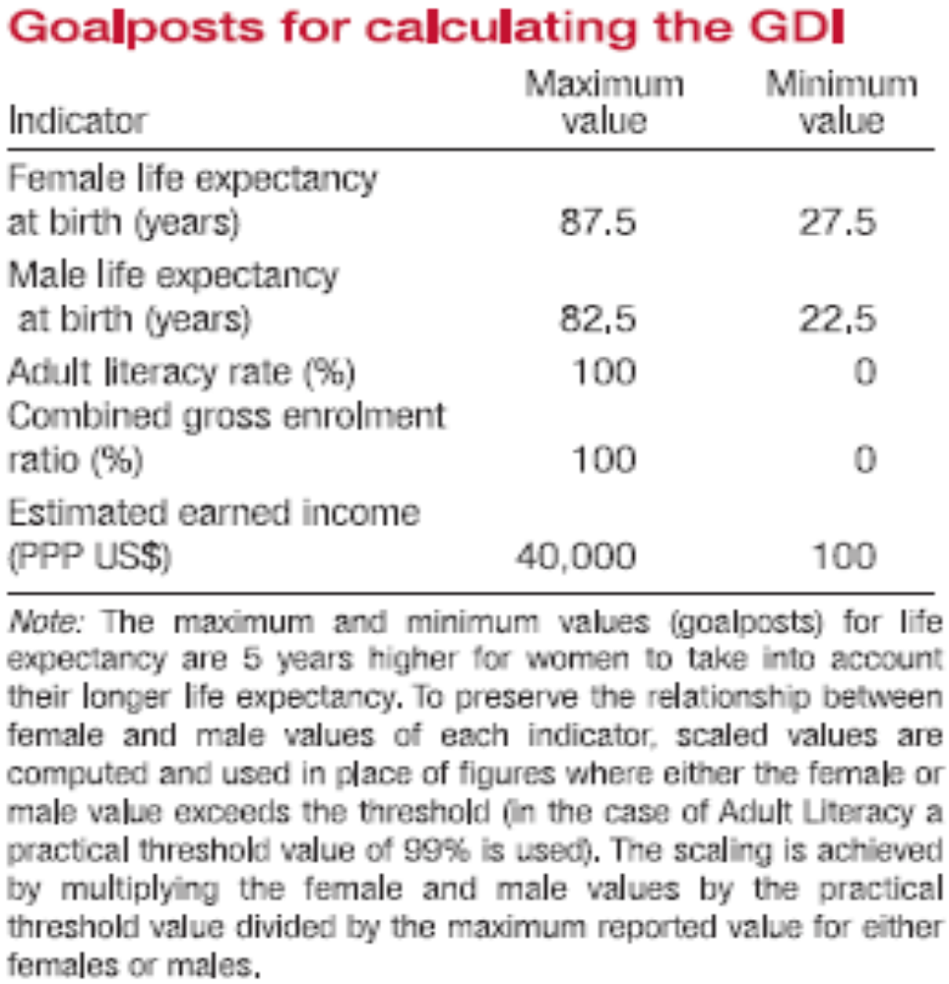

Slide 39
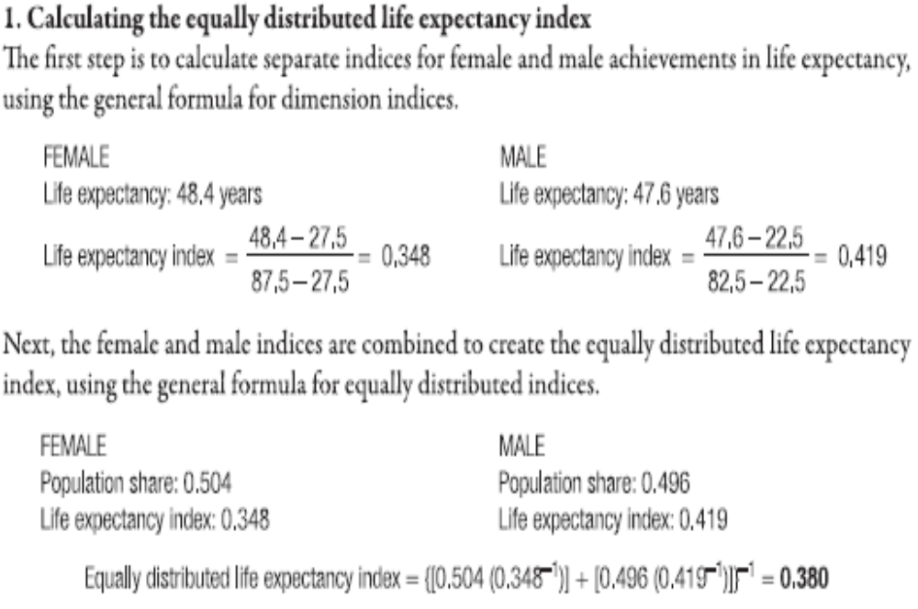

Slide 40
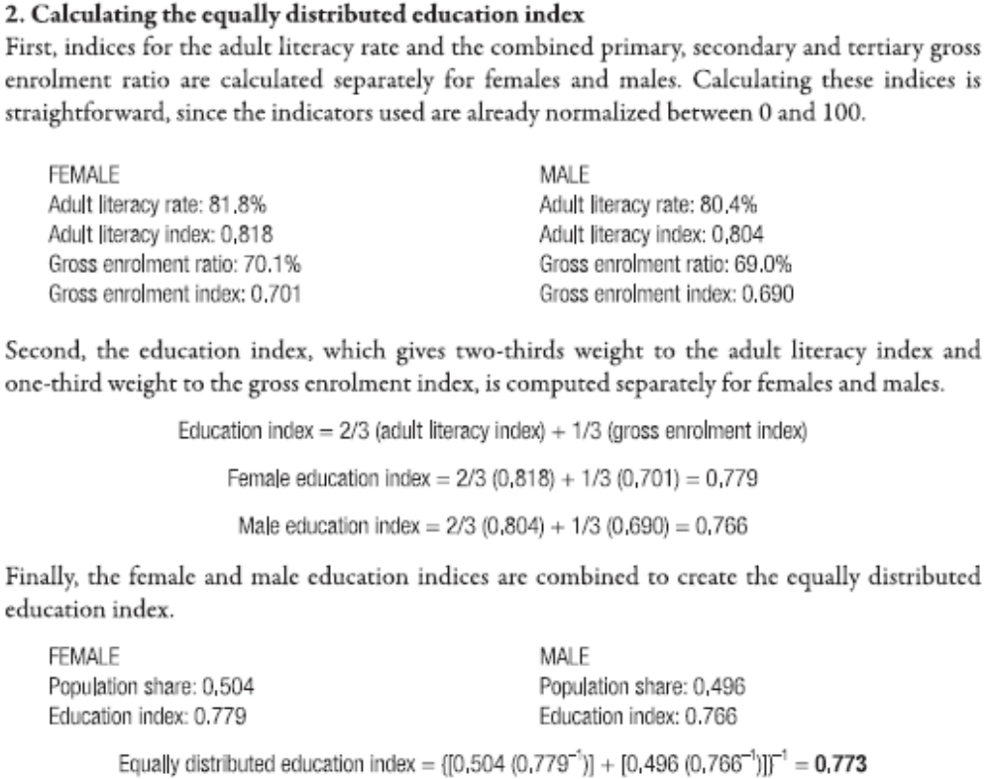

Slide 41
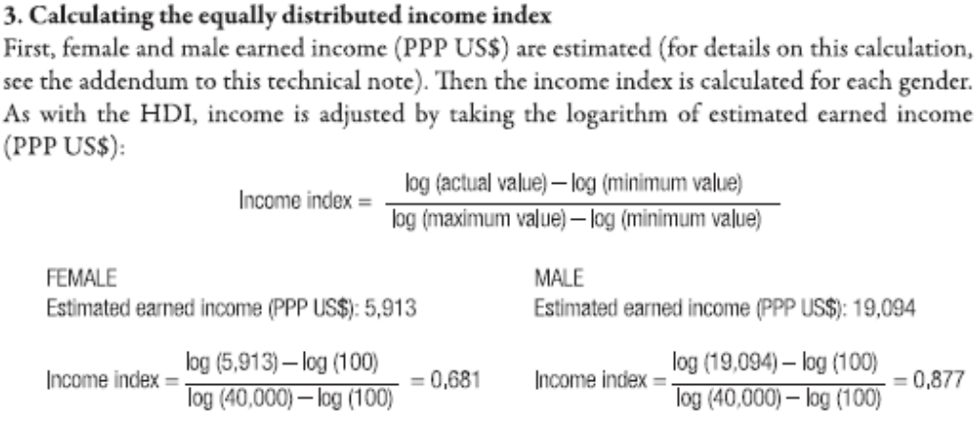
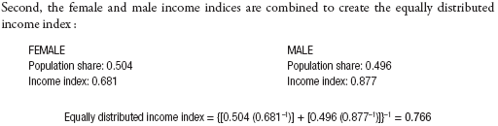

Slide 42
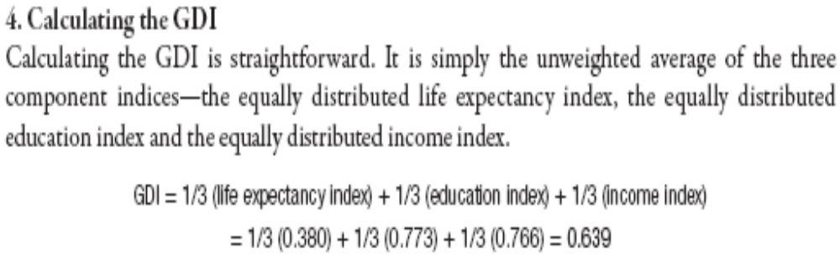

Slide 43
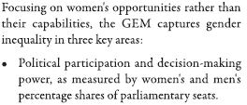
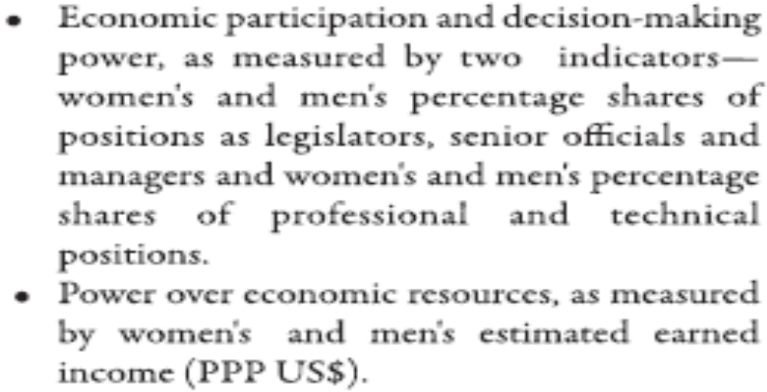
Gender Empowerment Measure

Slide 44
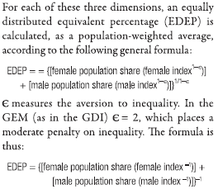

Slide 45
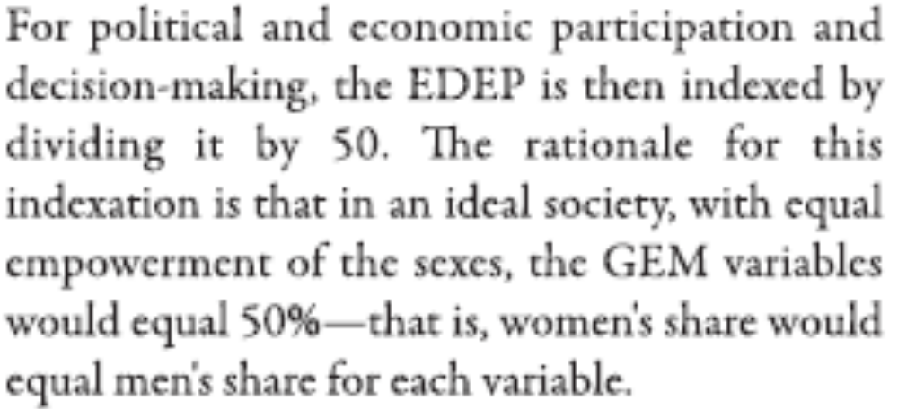
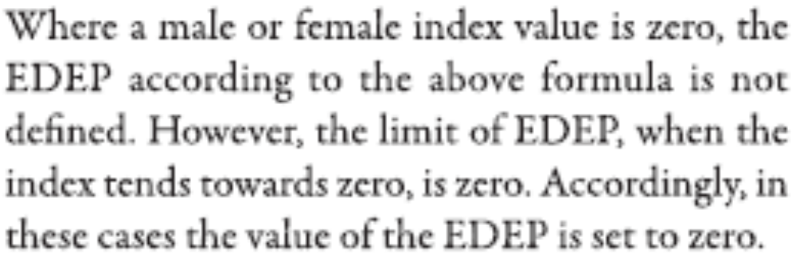

Slide 46
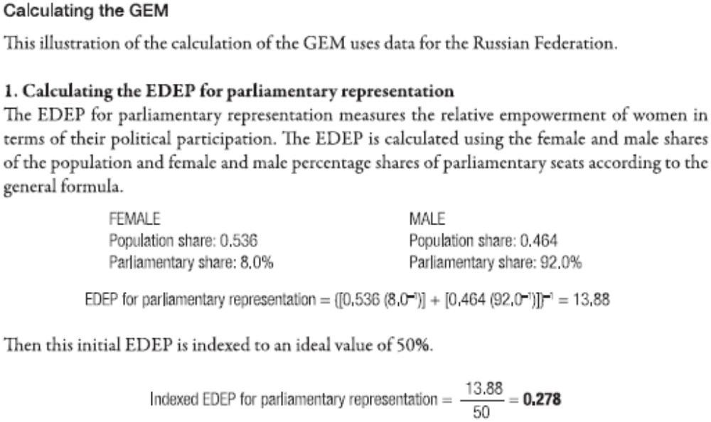

Slide 47
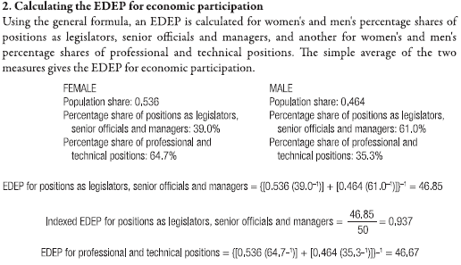

Slide 48
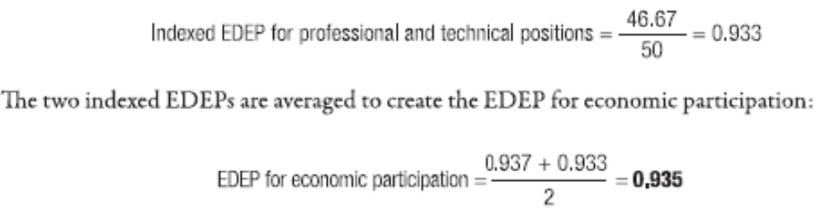
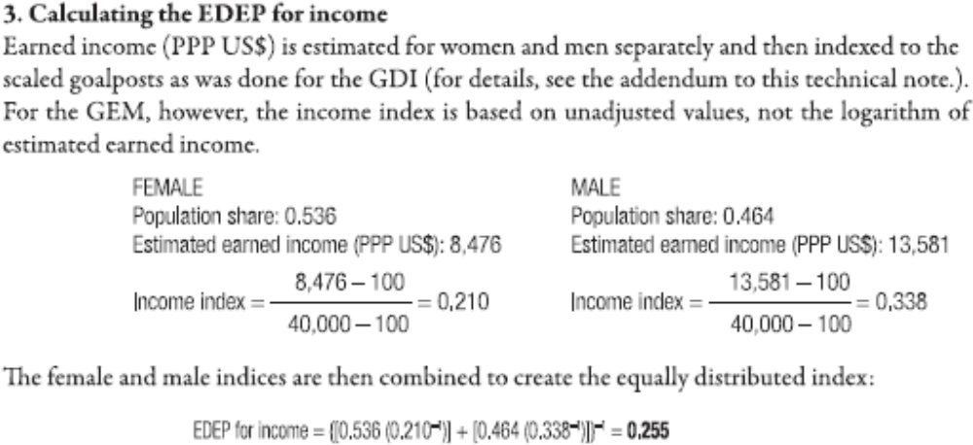

Slide 49
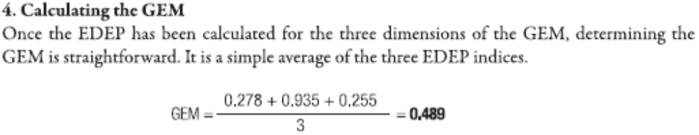

Slide 50
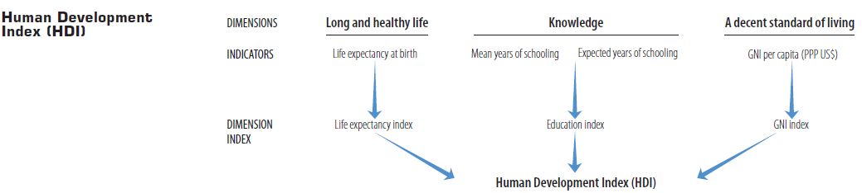
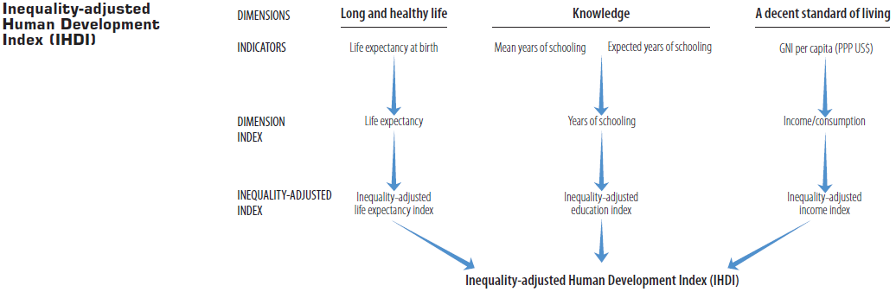

Slide 51
Inequality-adjusted Human Development Index
The Inequality-adjusted Human Development Index (IHDI) adjusts the Human Development Index (HDI) for inequality in distribution of each dimension across the population. It is based on a distribution-sensitive class of composite indices proposed by Foster, Lopez-Calva, and Szekely (2005), which draws on the Atkinson (1970) family of inequality measures.
It is computed as a geometric mean of geometric means, calculated across the population for each dimension separately.
The IHDI accounts for inequalities in HDI dimensions by “discounting” each dimension’s average value according to its level of inequality.

Slide 52
The IHDI equals the HDI when there is no inequality across people but is less than the HDI as inequality rises. In this sense, the IHDI is the actual level of human development (accounting for this inequality), while the HDI can be viewed as an index of “potential” human development (or the maximum level of HDI) that could be achieved if there was no inequality.
The “loss” in potential human development due to inequality is given by the difference between the HDI and the IHDI and can be expressed as a percentage.

Slide 53

Step 1. Measuring inequality in underlying distributions
There are three steps to computing the IHDI.
The IHDI draws on the Atkinson (1970) family of inequality measures and sets the aversion parameter ε equal to 1.
The inequality aversion parameter guides the degree to which lower achievements are emphasized and higher achievements are de-emphasized
In this case the inequality measure is A = 1– g/μ, where g is the geometric mean and μ is the arithmetic mean of the distribution.
This can be written as:

Slide 54

Where {X₁,…, X_{n}} denotes the underlying distribution in the dimensions of interest. A_{x} is obtained for each variable (life expectancy, years of schooling and disposable income or consumption per capita) using household survey data and the life tables.
The geometric mean in the A_{x} does not allow zero values. For mean years of schooling one year is added to all valid observations to compute the inequality.
Income per capita outliers-extremely high incomes as well as negative and zero incomes-were dealt with by truncating the top 0.5 percentile of the distribution to reduce the influence of extremely high incomes and by replacing the negative and zero incomes with the minimum value of the bottom 0.5 percentile of the distribution of positive incomes.

Slide 55


Step 2. Adjusting the dimension indices for inequality
The mean achievement in a dimension, , is adjusted for inequality as follows:

Slide 56


Step 3. Computing the Inequality-adjusted Human Development Index

Slide 57



Slide 58

Calculating the Gender Inequality Index
The Gender Inequality Index (GII) reflects women’s disadvantage in three dimensions-reproductive health, empowerment and the labour market. The index shows the loss in human development due to inequality between female and male achievements in these dimensions. It ranges from 0, which indicates that women and men fare equally, to 1, which indicates that women fare as poorly as possible in all measured dimensions.

Slide 59
There are five steps to computing the GII.
Step 1. Treating zeros and extreme values
The maternal mortality ratio is truncated symmetrically at 10 (minimum) and at 1,000 (maximum). The maximum of 1,000 is based on the normative assumption that countries where the maternal mortality ratio exceeds 1,000 are not different in their ability to create conditions and support for maternal health. Similarly, it is assumed that countries with 1–10 deaths per 100,000 births are essentially performing at the same level.
The female parliamentary representation of countries reporting 0 percent is coded as 0.1 percent because the geometric mean cannot have zero values and because these countries do have some kind of political influence by women.

Slide 60

Step 2. Aggregating across dimensions within each gender group, using geometric means

Slide 61

Step 3. Aggregating across gender groups, using a harmonic mean

Slide 62

Step 4. Calculating the geometric mean of the arithmetic means for each indicator

Slide 63



Step 5. Calculating the Gender Inequality Index

Slide 64

National HDR

Slide 65


Slide 66
The HDI has been estimated for all the States/Union Territories, separately for rural and urban areas, for early eighties, using data covering the period 1981 to 1983; for the early nineties, covering the period 1991 to 1993-94; and in case of selected major States for the year 2001, using data for the period 1999-2001.
At the national level, HDI, which takes a value between 0 and 1, has improved from 0.302 in 1981 to 0.381 in 1991.
The improvement for rural areas is from 0.263 to 0.340 and in case of urban areas, from 0.442 to 0.511.
Though the rural-urban gap continues to be significant, it has declined.
The ratio of urban to rural HDI has declined from around 1.7 in early eighties to 1.5 in early nineties.

Slide 67


Slide 68


Slide 69
GEI has been estimated to measure the inequality in attainments on human development indicators between females and males.
The index has been presented as a ratio of attainments for females to that of males.
Theoretically, the index can take values between zero and infinity, with a value of unity reflecting an absolute equality in the respective attainments of males and females. A value higher than unity would imply that females have better attainments than males.
However, in reality, the index is likely to take a value between zero and unity.

Slide 70
In estimating the index, the economic attainments for males and females have been captured by taking the respective worker population ratio, unlike the use of per capita monthly expenditure in the HDI.
This has been done, primarily, to avoid taking recourse to apportioning consumption or income, between males and females at the household or at an individual level, using criteria that could always be debated.
Moreover, worker population ratio, particularly for females in a developing society like India is, in some sense, a direct measure of the extent of empowerment that females have in a society.
Educational and health attainments have been captured using the same set of indicators as in the case of HDI.

Slide 71


Slide 72


Slide 73
The GEI, at the national level, was 0.620 in the early eighties, improving marginally to 0.676 in the early nineties.
At the State level, GEI was the highest for Kerala followed by Manipur, Meghalaya, Himachal Pradesh and Nagaland in the eighties.
In the nineties, Himachal Pradesh had the highest GEI, whereas Bihar was at the bottom and had witnessed a decline, in absolute terms, over the earlier period.
In general, women were better off in Southern India than in the Indo-Gangetic plain, comprising mainly the States of Bihar and Uttar Pradesh.

Slide 74


Slide 75


Slide 76
HPI
The HPI has been estimated to reflect the deprivational perspective on development. Indicators on three aspects of deprivation have been considered to construct the composite index.
Deprivation in health and longevity was captured essentially through the proportion of the population not expected to survive to age 40 years. In addition, proportion of population without access to basic medical services; proportion of deliveries not receiving medical attention; and proportion of children not immunized; were also included to reflect deprivation in health attainments.

Slide 77
Educational deprivation has been captured through illiteracy rates and children in the school going age group not enrolled in schools.
For capturing economic deprivation, proportion of population below a poverty line anchored in a food-adequacy norm; proportion of the population living in kutcha houses; proportion of population without access to sanitation; proportion of population without access to safe drinking water; and proportion of population without electricity, have been used.
While each of the three dimensions of deprivation, namely, educational, health and economic wellbeing have been given a one-third weight in the composite index, for each of the dimension, the composite measure has been estimated as an average of the relevant indicators.

Slide 78
The HPI takes value between 0 and 100 such that a higher deprivation for a State means a value closer to 100. In this case, it would imply that the entire population of the State is deprived of even the minimal attainments on each of the three dimensions.
At the national level, the proportion of the deprived on the HPI was 47.33 per cent in the early eighties. The proportion was significantly higher for rural areas at about 53 per cent, as against about 27 per cent in urban areas.
It declined to 39.36 per cent in the early nineties on the comparable HPI, and was a little less on the alternate HPI (with some changes in the included indicators) at 37.42 per cent.

Slide 79
The HPI for rural areas, on the comparable index, was about 45 per cent and was less than half at 22 per cent in case of urban areas. Thus, the decline in the rural areas was a litter higher than the decline in urban areas, resulting in a marginal decline in the rural-urban gap.
The inter-State differences in the HPI are quite striking. It was in the range of 55-60 per cent in the early eighties for the worse off States, namely, Orissa, Bihar, Arunachal Pradesh, Assam and Uttar Pradesh, and between 32-35 per cent in the better off States like Kerala, Punjab and Himachal Pradesh.
It was only in the smaller, predominantly, urban areas of Delhi and Chandigarh that had an HPI in the range of 17-20 per cent. The value of HPI in early nineties had declined in all the States.

